Slide 1
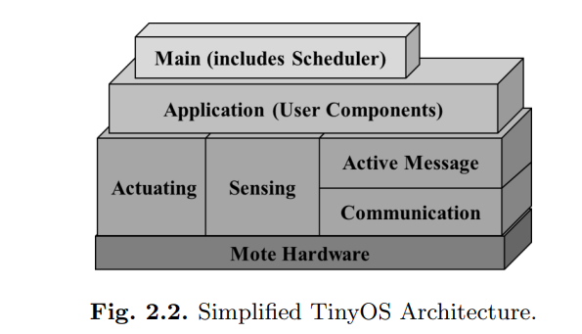
TinyOS Architecture

Slide 2
TinyOS Architecture
TinyOS uses the component model and, according to the requirements of an application, different components are glued together with the scheduler to compose a static image that runs on the mote.
A component is an independent computational entity that exposes one or more interfaces.
Components have three computational abstractions: commands, events, and tasks.
Mechanisms for inter-component communication are commands and events. Tasks are used to express intra-component concurrency.
A command is a request to perform some service, while the event signals the completion of the service.
TinyOS provides a single shared stack and there is no separation between kernel space and user space.

Slide 3
TinyOS Execution Model
The approach to these requirements we focus on
two broad principles:
• Event Centric: Like the applications, the solution must be event centric. The normal operation is the reactive execution of concurrent events.
• Platform for Innovation: The space of networked sensors is novel and complex: we therefore focus on flexibility , enabling innovation, performance, small size, lightweight concurrency and support for low power operation

Slide 4
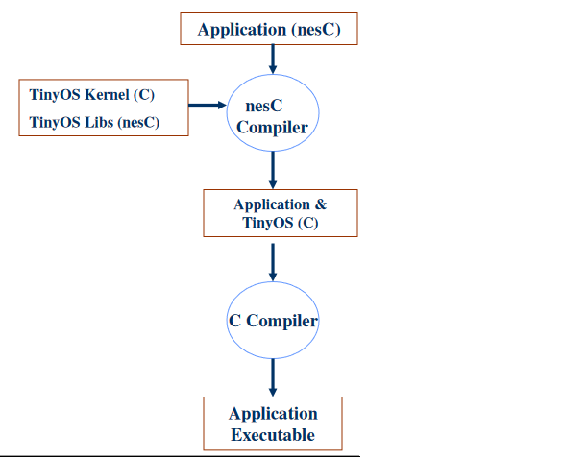
TinyOS Execution Model
nesC
nesC is an extension of C
Built on top of gcc
“Static Language”
  No Dynamic Memory (no malloc)
  No Function Pointers
  No Heap
TinyOS evolved to nesC
Java influence
nesC uses the filename extension ".nc"

Slide 5
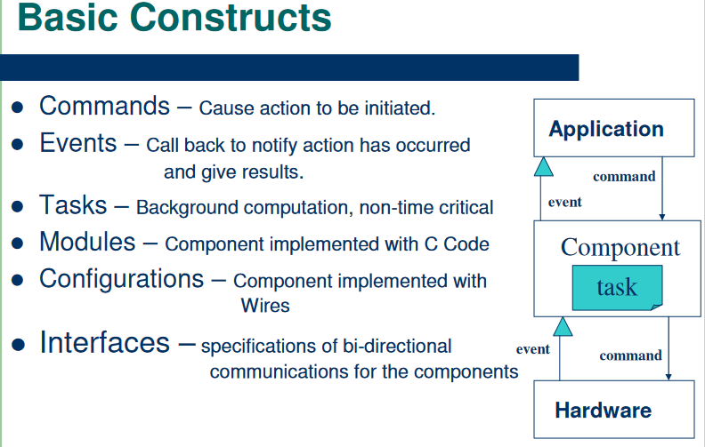

Slide 6
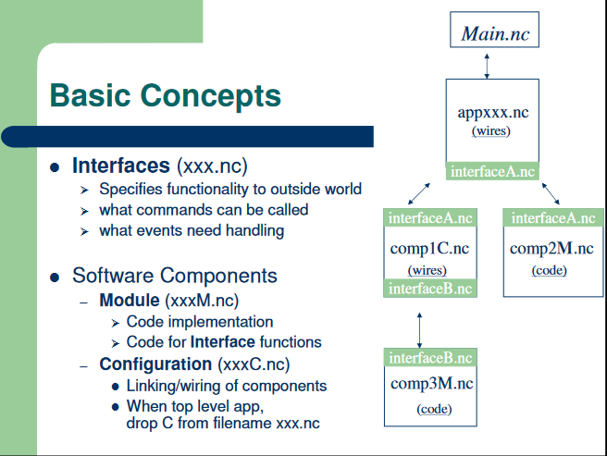

Slide 7
TinyOS Execution Model :Threaded Model
Threads of control are rooted in two places
  Hardware Interrupts
  Tasks
Threads of control may pass into component through its
interfaces to another component.
Interrupt Handlers may interrupt tasks and other interrupts.
Tasks run to completion and may NOT be interrupted by other Tasks.
nesC scheduler executes Tasks from a FIFO queue

Slide 8
Execution Model
The event-centric domain of sensor networks requires fine-grain concurrency;
events can arrive at any time and must interact cleanly with the ongoing computation.
This is a classic systems problem that has two broad approaches:
(1) atomically queuing work on arrival to run later, and
(2) executing a handler immediately in the style of active messages

Slide 9
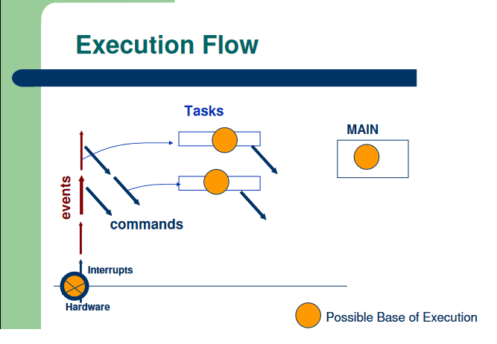
Execution Model
The core of the execution model consists of run-to-completion tasks that represent the ongoing computation, and interrupt handlers that are signaled asynchronously by hardware.

Slide 10
Execution Model
Tasks are an explicit entity in the language
a program submits a task to the scheduler for execution with the post operator.
The scheduler can execute tasks in any order, but must obey the run-to completion rule.
The standard TinyOS scheduler follows a FIFO policy, but other policies like earliest-deadline first may be implemented.
Because tasks are not preempted and run to completion, they are atomic with respect to each other.
However, tasks are not atomic with respect to interrupt handlers or to commands and events they invoke.

Slide 11
Execution Model
To facilitate the detection of race conditions, we distinguish synchronous and asynchronous code:
• Synchronous Code (SC): code that is only reachable from tasks.
• Asynchronous Code (AC): code that is reachable from at least one interrupt handler

